Slide 1
Defending Warm-ups and Technique

Slide 2
Defending warm-up (1)
2 groups , reds and blues. Reds attackers blues defenders
Reds dribble to outside cone (orange) and then inside cone (yellow)
Blues track as defenders showing outside and inside from goal at end
Run round the outside once they get to the end and swap over for next go

Slide 3
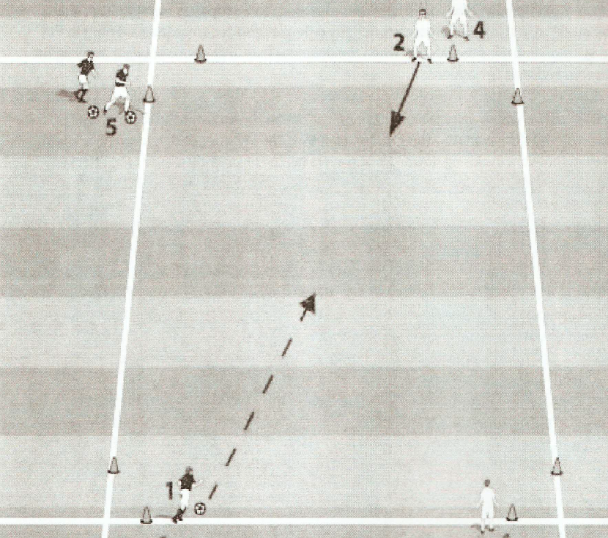
Alternate Defending Warm-up

Slide 4
Defending – Technique session
12 players – 4 groups of 3
Small Cone Goal
Group 1 (Servers)
Group 2 (Attackers)
Group 3 (Defenders)
Ball Pass
Run off the ball
Run with the ball
1 Ball per group
1v1 – 4 groups of 3
Server passes to attacker defender practises closing down.
2v2 – 3 groups of 4
As before but 2 defenders server joins attacker to make 2v2
3v3 – 2 groups of 6
As before but 3 defenders, 2 attackers, server joins attackers to make 3v3

Slide 5
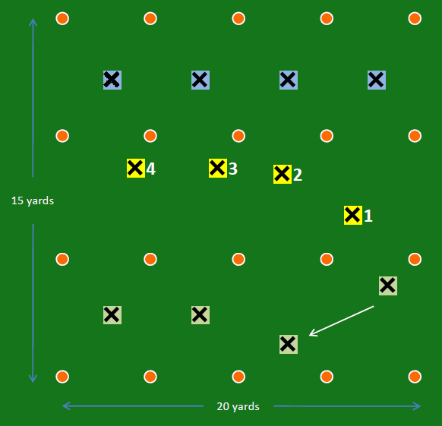
Defending as a Unit – Warm-up/Technique session (2)
9 or 12 players
3 teams in different colour bibs.
Each player works in a 5m x 5m box
Idea is for the outside team to pass
to the other outside team.
Defending team in the middle has to stop them
Concentrate on player to the ball, covering player(Passing channel) and balance/marking players. Adjust positions as ball move zones. Teach correct principles.
Have a competition for each defending side to see how many passes they let through in 5 attempts, lowest score wins
Add bounce players to the sides.

Slide 6
Defending FP’s

Slide 7
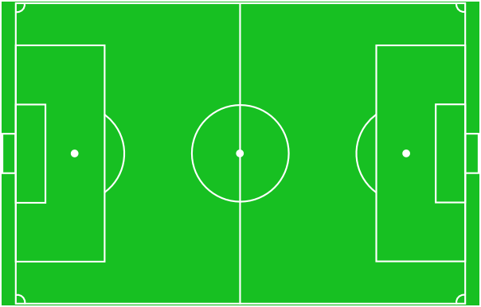
PRINCIPLES OF DEFENDING - FP – Coach a Back four cover and balance – Concepts
DIAGRAM A – Pattern 1
Ball with A4. If A4 is left footed, D4 makes a curved run to show A4 inside, leading with right shoulder and right foot. (If A4 is right footed D4 shows A4 outside)
D3 provides cover for D4, at a distance where D3 can affect the play if D4 is beaten. D3 also cuts the passing channel. D3 can see the ball, D3 leads with right shoulder and watches A3 also
D2 is the last man (Always a centre back) providing cover and watches A2 also.
D1 comes in to provide balance, but can reach A1 if ball is switched
SAUCER SHAPE of back 4
A1
D1
A2
D2
A3
D3
D4
A4
DIAGRAM B – Pattern 2
Ball passed to A3 and as the BALL TRAVELS then
D3 presses A3.
D2 pushes up a little and provides cover for D3 and watches A2.
D4 drops off A4 provides cover to D3 and watches A4.
D1 moves out closer to A1 to mark space and provide balance.
Defensive line must not become too jagged and present a SAWTOOTH.
This is repeated with the ball played to A2, D2 presses, D3 covers as does D1
A1
D1
A2
D2
D3
A3
D4
A4
Legend:
Movement without the ball
Pass, shot
Movement with the ball (RWTB)

Slide 8
PRINCIPLES OF DEFENDING - FP – Coach a Back four cover and balance – Concepts
DIAGRAM C – Pattern3
Ball passed from A3 to A1. If A1 is right footed D1 will make a curved run to show A1 inside leading with the left shoulder. If A1 is left footed D1 will show A1 outside on their weaker foot.
D2 provides cover to D1 whilst watching A2.
D3 provides balance whilst watching A3
D4 Marks space in front of the ball being able to react quickly should the ball be switched to A4.
D1
A1
D2
A2
D3
A3
D4
DIAGRAM D – A strategy: man to man with zonal areas
A4
In a defensive strategy like this, the following points are relevant
Zones are guidelines
Defenders should not ball watch but defend the player(s) in their zone.
Defenders can move out of their zone to provide cover and balance (mark space) to help other defenders in other zones as the ball is played to other attackers
Attacking players may be transferred from defender to defender especially in the case of a switch-over by strikers. TRANSFER THE ATTACKING PLAYER not get drawn out of position and shape.
D1
D2
D3
D4
Legend:
Movement without the ball
Pass, shot
Movement with the ball (RWTB)

Slide 9
Patterns of Play - FP - Coach a back four cover and balance
Primary Players in functional practice – Back four – centre backs and full backs
Secondary players in functional practice – Goalkeeper and central midfielders
Observe movements and coach when: -
The ball is played quickly into a Wide Player via midfield – coach defensive position on back four unit, involve GK and defensive midfielders. What happens if the 1st defender (full back ) is beaten?
The ball is played quickly into a central striker – coach defensive position on back four unit, involve GK and defensive midfielders. What happens if the 1st defender (centre back) is beaten?
The ball is played in quickly to a wide player or central player then laid back to central midfielder for switch to opposite side of pitch –coach position and adjustment of back four as the play is switched from flank to flank or player to player. (2 movements)
Session Management (Strategy – Structure)
Attacking side to play quickly into the front players (Wide Midfielder or Central Strikers) and try to score. Attackers to try and take on 1st defender if possible
Pitch 50yds long (To halfway line) . 7v6. Defenders 6 (4-2)plus GK, attackers 6(4-2) . 2 Servers. If defenders get the ball 5 touches to get through goals or clear, if under pressure to target goals.
Pressing defence first with high line on third then later drop (For progression see below) allow attackers the ball. Work with defending team (BLUES).
Work with units/groups of players on Coached side to establish Patterns of play.
If defenders win the ball play the ball out or clear to target goals
PROGRESSION allow servers to join attack and create 8v7 overload for attackers
See Diagrams and session plan for explanations of pattern of movements to coach

Slide 10
Defending Phases Of Play

Slide 11
PRINCIPLES OF DEFENDING - FP – – Coach a Back four Cover and Balance
Organisation: Pitch 50yds long (To halfway line) . Work with defending team (BLUES).
Pattern : S1 to S2. S2 passes to either A3,A4, A5 or A6 based on coaches command.
Progression: A 3, A4, A5 or A6 lay ball back to S1 or S2 who then plays the ball back into another (or same) player.
Add 2 defensive midfielders allow S1 and S2 to become attacking midfielders.
A6
D1
S2
A5
60 Yards
D2
GK
A4
S1
D3
D4
A3
Asst Ref
Legend:
Movement without the ball
Pass, shot
Movement with the ball (RWTB)
DIAGRAM 1

Slide 12
PRINCIPLES OF DEFENDING - FP – – Coach a Back four Cover and Balance
Organisation: Pitch 50yds long (To halfway line) . 7v6. Defenders 6 (4-2)plus GK, attackers 6(4-2) . 2 Servers. If defenders get the ball 5 touches to get through goals or clear. Press first high line defence on third then later drop allow attackers the ball. Work with defending team (BLUES). Progression: Allow one server to join the attack
Pattern 1: S1 to S2. A2 checks off D6 and A2 passes into A3, observe defence. A3 attempts to beat D4. (Repeat other side to A6 via A1)
A6
D1
A1
S2
A5
60 Yards
D2
GK
D5
A4
S1
D3
D6
A2
D4
A3
Asst Ref
Legend:
Movement without the ball
Pass, shot
Movement with the ball (RWTB)
DIAGRAM 1

Slide 13
PRINCIPLES OF DEFENDING - FP – – Coach a Back four Cover and Balance
Organisation: Full pitch width by 50yds long (To halfway line) . 7v6. Defenders 6 (4-2)plus GK, attackers 6(4-2) . 2 Servers. . If defenders get the ball 5 touches to get through goals or clear. Press first high line defence on third then later drop allow attackers the ball. Work with defending team (BLUES). Progression: Allow one server to join the attack.
Pattern 2: S1 to S2. A2 checks off D6 and A2 passes into A4, (or S2 direct to A4) observe defence. A4 attempts to beat D3. (Repeat other side to A5 via A1)
A6
D1
A1
S2
A5
D5
60 Yards
D2
GK
A4
D3
S1
D6
D4
A2
A3
Asst Ref
Legend:
50 Yards
Movement without the ball
Pass, shot
Movement with the ball (RWTB)
DIAGRAM 2

Slide 14
PRINCIPLES OF DEFENDING - FP – – Coach a Back four Cover and Balance
Organisation: Full Pitch Width by 50yds long (To halfway line) . 7v6. Defenders 6 (4-2)plus GK, attackers 6(4-2) . 2 Servers. . If defenders get the ball 5 touches to get through goals or clear. Press first high line defence on third then later drop allow attackers the ball. Work with defending team (BLUES). Progression: Allow one server to join the attack. Pattern 3: S2 to S1. S1 to A4 back to A2 switch to A6 (Up, back and Over).
A6
3
D1
A1
S2
D2
A5
60 Yards
D5
GK
A4
1
D3
S1
D6
2
D4
A2
A3
Asst Ref
Legend:
Movement without the ball
Pass, shot
Movement with the ball (RWTB)
DIAGRAM 3

Slide 15
Defending in an SSG (8v8 – 3-2-2)

Slide 16
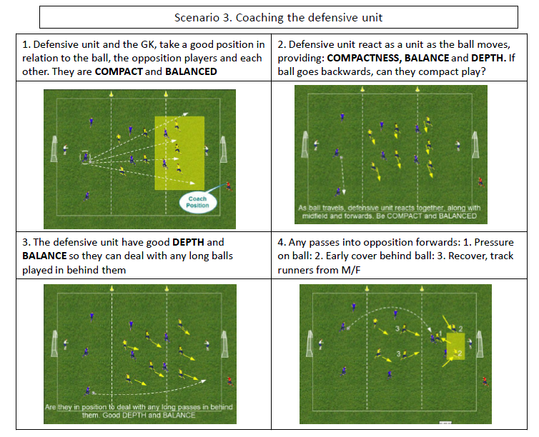
1

Slide 17
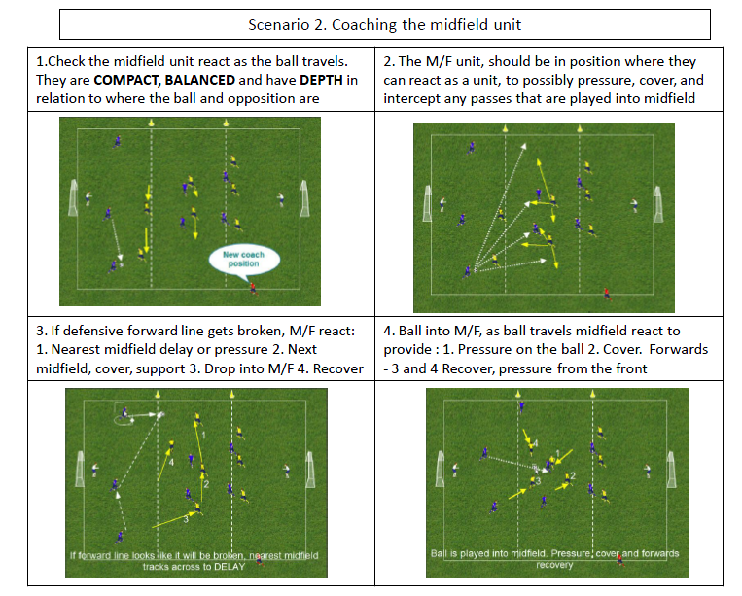

Slide 18
Defending Key Technical Factors

Slide 19
Key Factors - Coach a Back Four Cover and Balance
1. Individual techniques and points
Individual defending technique – Fast Shutdown, slow down, get down, side on
All defenders to adopt a good body stance, left or right shoulder, side on, defensive triangle, the player, the ball, the goal. Do not get pinned or behind your player, Whole team adjusts off pressing players stance.
Track runners to back of defence. Recover from wrong side of the ball, if it is behind you.
Defenders can show inside (to strength) or outside (away from goal) depending on the player (weak foot) and situation they are dealing with. Make play predictable.
2. Cover and Balance (UNIT)
Movement and responsibility of supporting (COVER) player
Nearest defender to decide to press or not (Decision based on Players forward, where the ball is lost. Can we affect the first touch, intercept or win the ball?) If not able to press, compact play, delay, cut out forward passes
Next nearest defender to COVER 1st defender, cut out the passing channel (screen).
Angle and distance of cover player to be able to make ground if 1st defender is beaten
to give support/confidence/advice (Communication) to 1st defender
to watch the player they are marking and to assess/anticipate danger and possible outcome
Movement of further BALANCE players to maintain shape/ compactness/ defensive cover/ balance. Mark their player and easily defend if the ball is switched to them
In an interchange of positions by the attack pass the player.
PLAYERS CHANGE ROLES ALSO from pressing, covering and balance player as ball is played.
Communication, Joe press, Fred Cover, Bill balance

Slide 20
Key Factors Coach a Back Four Cover and Balance
3. Defensive line
Hold position and line (Chain) across the back of the defensive line. Squeeze centrally behind the ball.
One of the centre backs is last man not a full back (Saucer shape). Never get too far (10m) from next nearest defender (Rope theory). Comfortable in being able to make up distance
Play offside with the last man in control (“Step up”). One CB player leads the back four.
PRESS & DROP - Once defensive line is good coach when to press and when to drop. Press when attackers are playing with their heads down, going back or across. Drop when there is no pressure on the ball carrier, to protect the ball over the top, but must engage as attackers get into shooting range (Draw a line of confrontation)
4. Communication Other Points
Communicate with Individuals - “Tuck In”, “Left Shoulder”, “Right Shoulder”.
Good communication with unit from pressing, cover , balance players and especially the goalkeeper. Use mental constructs, key words: “Out”, Press”, “Drop”, “Hold (the line)”, “Shift Left”, “Shift Right”.
GK to assess when to communicate with defence and when to concentrate on ball.
GK to adopt a good defensive position in relation to the ball and defensive area behind the line and be comfortable with the distance
Central Midfield players to front screen attackers and apply pressure to ball carrier.
If the ball is won under pressure deal with it & clear lines, otherwise play out and push up.
See Diagrams and session plan for explanations of pattern of movements to coach

